Slide 1














Usability Testing on
Google Flights
Group No 38

Slide 2

Introduction
Usability Metrics tested for Google Flights
1.Effectiveness - Independent Sample Test
2.Efficiency - Paired Sample Test
3.Error Rate - Anova
4.Learnability - Pearson Correlation

Slide 3

Google Flights
https://www.google.com/travel/flights

Slide 4
Independent Sample Test
Effectiveness
  Research Question : Is there a significant difference in the Task Completion Success Rate for finding a mutli-city itinerary between users with prior knowledge of Google Flights and users with no prior knowledge?
  Null Hypothesis : There is no significant difference in the mean Task Completion Success Rate (μ) for the multi-city search between users with and without prior knowledge of Google Flights.
  Alternative Hypothesis : The mean Task Completion Success Rate (μ₁) for users with prior knowledge will be significantly higher than the mean Task Completion Success Rate (μ₂) for users with no prior knowledge.
  Independant Variable : Prior Knowledge (a categorical variable with two levels: ‘Yes’ or ‘No’)
  Dependent Variable : Task Completion Success Rate (a binary variable:1 =Success, 0 =Failure)

Slide 5
Independent Sample Test
Effectiveness
  Experimental Design : Between-Subjects Design (Independent Measure)
  Procedure Type : In-Person Moderated Procedure
  Justification : In-person moderated setup provides the highest level of data integrity for this experiment. By conducting the test in a controlled lab, environmental variables are reduced.
  Test Material : The pre-test survey contains the key questions and Post-Test Survey Question includes the success/failure question.In-person moderated setup provides the highest level of data integrity for this experiment.

Slide 6
Paired Sample Test
Efficiency
  Research Question: How does the average time taken by users to select a flight itinerary that meets complex criteria (e.g., maximum one-stop, specific time of the day, cheapest option) differ when utilizing Google Flights' advanced filtering panel compared to relying solely on analyzing the linear search results list?
  Null Hypothesis : The study aims to determine if there is a significant difference in the average time required for users to successfully identify and select a flight itinerary that meets complex, predefined criteria when they use the advanced filtering panel on Google Flights versus when they rely on manual scanning and basic filtering of the linear search results.
  Alternative Hypothesis : The average amount of time required to select a complex flight itinerary differs significantly when users utilize the advanced filtering panel compared to when they rely on the linear search results list alone.

Slide 7
Paired Sample Test
Efficiency
  Independent Variable - Method of Itinerary Selection
  Dependent Variable- Time taken (in seconds/minutes) for the user to successfully select a flight itinerary that meets all complex criteria.
  Experimental Design : Within-Subjects Design
  Procedure Type : Inperson Moderated testing
  Test Material : Structured instruction and The Pre-Test Questionnaire Form

Slide 8
Anova
Error Rate
  Research Question: Do users with different levels of flight-booking experience (novice, intermediate, and expert) differ significantly in the number of errors they make when completing a flight-search task on Google Flights?
  Null Hypothesis : There is no significant difference in mean error rate among novice, intermediate, and expert users on Google Flights.
  Alternative Hypothesis : There is a significant difference in mean error rate between at least two of the experience groups
  Independent Variable - User experience level (Novice, Intermediate, Expert)
  Dependent Variable- Error Count (total number of errors recorded using a structured error checklist.)

Slide 9
Anova
Error Rate
  Experimental Design : Between-Subject Design
  Procedure Type : Inperson Moderated testing
  Test Material :
Structured task instruction sheet.
Pre-task survey.
Error checklist used during observation.
Post-task questionnaire.

Slide 10
Pearson Correlation
Learnability
  Research Question : Is there a relationship between the reduction in task completion time from a first attempt to a second attempt at applying advanced filters on Google Flights and the user's post-test confidence rating in using those filters?
  Null Hypothesis : There is no significant correlation (ρ=0) .
  Alternative Hypothesis : There is a significant correlation (ρ ≠ 0) between the reduction in task completion time and the user's post-test confidence rating in using advanced filters on Google Flights.
  Dependent Variable : The user’s post task confidence rating in using advanced filters.
  Independent Variable : Time Reduction Score

Slide 11
Pearson Correlation
Learnability
  Experimental Design : Within-Subject Design
  Procedure Type : Moderated Remote testing
  Justification : The session is guided to ensure the tutorial is delivered consistently during both attempts. Conducting the test remotely enhances participant convenience and helps recruit a larger, more diverse group of users
  Test Material : A Structured task instruction for the participant and a post-task questionnaire to gather participant rating

Slide 12

Data Collection and Tools
Data Collection :
Google Forms to get survey from participants.
Tools :
  Google Sheets: Filter surveys, View Survey Results and Calculations.
  Google Slides: To make presentation slides.
  Google Docs: To make and align Test Report

Slide 13
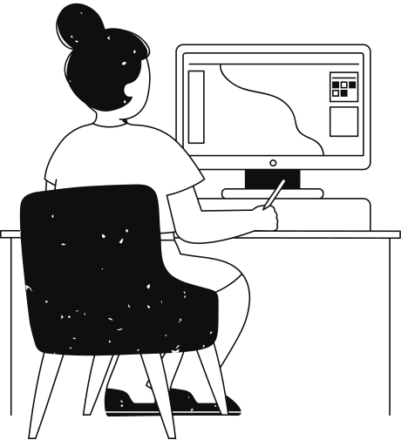
Participant and Ethics
  Participants: Individuals above 18 years old were recruited through social media and email distribution for the survey.
  Recruitment Method: Participation was voluntary and involved random selection to ensure diversity in responses.
  Ethical Compliance: All actions adhered strictly to the approved ethical form, with no deviations or violations of outlined guidelines.

Slide 14
Conclusion
  Conducted comprehensive usability evaluation of Google Flights with 20 student participants
  Measured effectiveness, efficiency, error rate, and learnability using four statistical techniques
  Employed both within-subjects and between-subjects designs for comparative insights
  Used standardized testing materials: Task Instructions, Consent Forms, Pre- and Post-Test Questionnaires
  Maintained controlled environment to ensure data consistency and ethical compliance
  Analyzed data using Independent-Sample Tests, Paired-Sample Tests, ANOVA, and Pearson Correlation
  Statistical results guided acceptance or rejection of hypotheses
  Findings highlight areas for improving complex features like multi-city search and advanced filters

Slide 15
Thank You

